Slide 1
Das Leibniz-Institut für Europäische Geschichte in Mainz
IEG

Slide 2
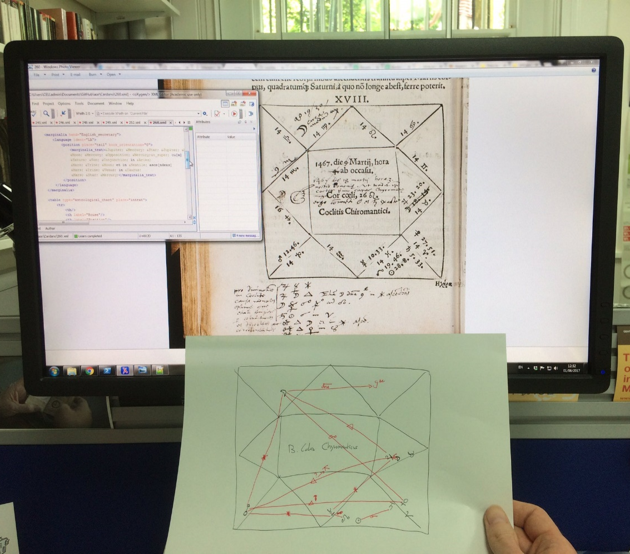
Introduction to XML

Slide 3
Content
A brief history of XML
The basics: elements and attributes
XML DTD & Schema
TEI
XML editors

Slide 4
A brief history of XML
eXtensible Markup Language
Developed in the mid-1990s
HTML: focus on capturing “presentation layers”
Standerdized General Markup Language: very technical
XML as alternative for SGML
Describing and capturing data
Data exchange & creation of structured data

Slide 5
Elements and Attributes (1)
Elements: the main building blocks of XML
Elements: describe and contain particular data
Attributes: define properties of elements (metadata)
Example:
<recipe>
<recipe name =‘’>

Slide 6
Elements and Attributes (2)
<recipe> This is the recipe to make apple pie. One needs the following ingredients. Start with peeling the apples…
</recipe>
<recipe name=‘Apple Pie’> One needs the following ingredients. Start with peeling the apples…
</recipe>

Slide 7
Elements and Attributes (3)
<recipe name=‘Apple Pie’ ingredient=‘apples’>
Start with peeling the apples…
</recipe>
<recipe name=‘Apple Pie’ ingredients=‘apples; sugar; flour’>
Start with peeling the apples…
</recipe>

Slide 8
Elements and Attributes (4)
<recipe name=‘Apple Pie’>
<ingredient name = ‘Apple’ type = ‘Goudreinet’/>
<ingredient name =‘Sugar’ type = ‘Brown sugar’/>
<instructions>Start with peeling the apples…</instructions>
</recipe>

Slide 9
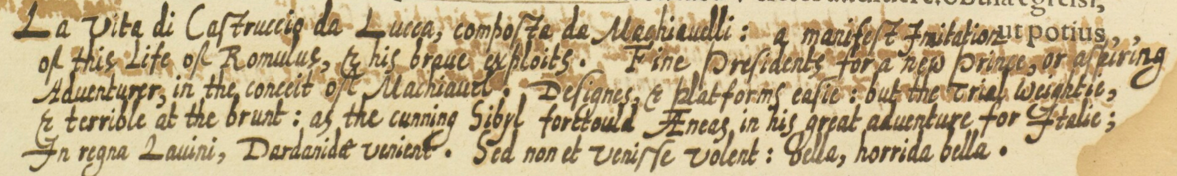
<marginalia hand="Italian"> <language ident="IT"> <position place="tail" book_orientation="0"> <marginalia_text>La vita di Castruccio da Lucca, composta da Machiauelli:</marginalia_text> <person name="Machiavelli"/> <book title="La vita di Castruccio Castracani"/> </position> </language> <language ident="EN"> <position place="tail" book_orientation="0"> <marginalia_text>a manifest Imitation of this Life of Romulus, &amp; his braue exploits. Fine Presidents for a new Prince, or aspiring Aduenturer, in the conceit of Machiauel. Designes, &amp; platforms easie: but the Trial weightie, &amp; terrible at the brunt: as the cunning Sibyl foretould A[e]neas, in his great aduenture for Italie;</marginalia_text> <person name="Romulus"/> <person name="Machiavelli"/> <person name="Aeneas"/> <person name="Cumaean Sibyl"/> <X-ref person="Virgil" book_title="Aeneid"/>

Slide 10
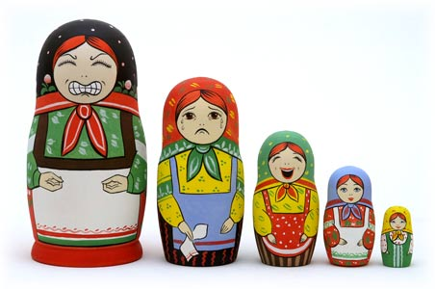
XML DTD & Schema
Document Type Definition
<!ELEMENT recipe (ingredients+, instructions)> <!ATTLIST recipe name CDATA #REQUIRED> <!ELEMENT ingredients EMPTY> <!ATTLIST ingredients name CDATA #REQUIRED> <!ATTLIST ingredients type CDATA #IMPLIED> <!ELEMENT instructions (#PCDATA)>

Slide 11
XML Schema
<xs:schema xmlns:xs="http://www.w3.org/2001/XMLSchema" elementFormDefault="qualified"> <xs:element name="recipe"> <xs:complexType> <xs:sequence> <xs:element maxOccurs="unbounded" ref="ingredients"/> <xs:element ref="instructions"/> </xs:sequence> <xs:attributeGroup ref="attlist.recipe"/> </xs:complexType> </xs:element> <xs:attributeGroup name="attlist.recipe"> <xs:attribute name="name" use="required"/> </xs:attributeGroup> <xs:element name="ingredients"> <xs:complexType> <xs:attributeGroup ref="attlist.ingredients"/> </xs:complexType> </xs:element> <xs:attributeGroup name="attlist.ingredients"> <xs:attribute name="name" use="required"/> <xs:attribute name="type"/> </xs:attributeGroup> <xs:element name="instructions" type="xs:string"/> </xs:schema>

Slide 12
TEI
Text Encoding Initiative
Active community since the 1980s
“ a consortium which collectively develops and maintains a standard for the representation of texts in digital form”
Main output: Guidelines (P5)
Overly descriptive and dense?

Slide 13
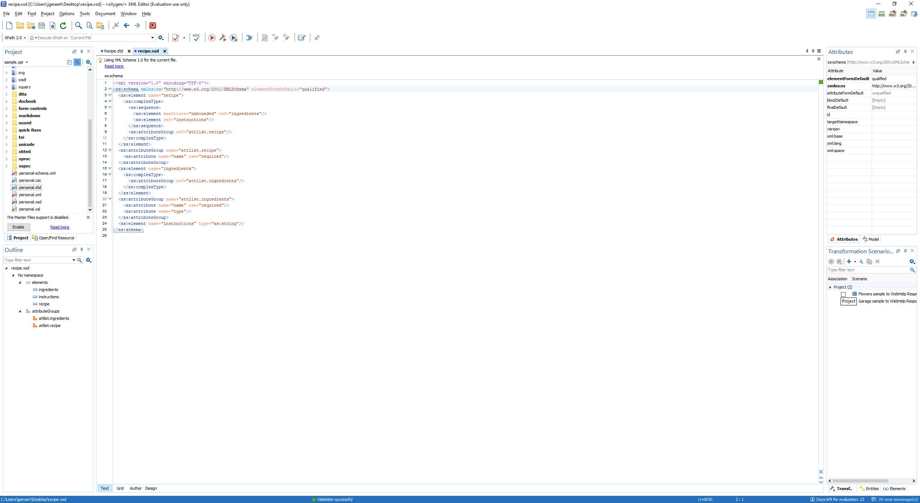
XML editors
Create/convert DTD & schema
Create XML files based on a schema
Validate XML files

Slide 14

Vielen Dank für Ihre Aufmerksamkeit

